Slide 1
For Live Session Unit 4
Andrew Leppla

Slide 2
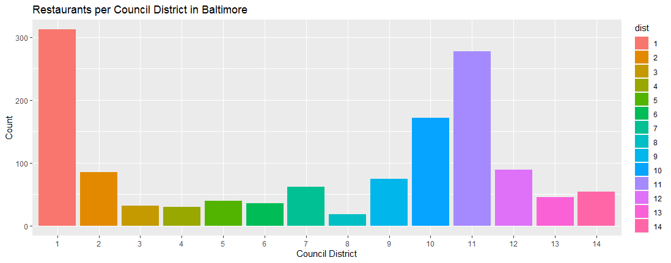
Part 1: Restaurant Data from Baltimore
There are approximately 9 sushi restaurants in Baltimore
There appears to be only 1 sushi restaurant in downtown Baltimore (county district 11)
Bar plot:
Notes:
#Scrape the XML page for name, zipcode and city council district. (Use either the XML or rvest package.)
data <-getURL("https://d396qusza40orc.cloudfront.net/getdata%2Fdata%2Frestaurants.xml")
doc <- xmlParse(data)
names <- xpathSApply(doc,"//name",xmlValue)
zipcode <- xpathSApply(doc,"//zipcode",xmlValue)
dist <- xpathSApply(doc,"//councildistrict",xmlValue)
#Make a dataframe with just those columns.
rests = data.frame(names,zipcode,dist)
#Are there any Sushi restaurants in Baltimore? (Where the dataset is from.)
#If so, can you estimate how many?
length(grep("SUSHI",rests$names))
#Filter the dataframe for just downtown restaurants (Council District 11).
dwntwn = rests %>% filter(dist=="11")
#Are there any Sushi restaurants downtown?
# research the “grep” function
length(grep("SUSHI",dwntwn$names))
#Make a barplot of the estimated number of restaurants (Sushi or otherwise) in each council.
rests$dist=factor(rests$dist,levels=c(1:14))
rests %>% ggplot(aes(dist,fill=dist)) + geom_bar() + ggtitle("Restaurants per Council District in Baltimore") +
xlab("Council District") + ylab("Count")

Slide 3
Part 2: Freestyle! Intrinio API
I wanted to learn more about the Intrinio API for stocks research. The API from Async was outdated and not documented on their website for adaptation.
Challenge #1 - The current API package was not on CRAN, so I cloned it from GitHub and then installed it
git clone https://github.com/intrinio/r-sdk.git
https://docs.intrinio.com/documentation/r

Slide 4
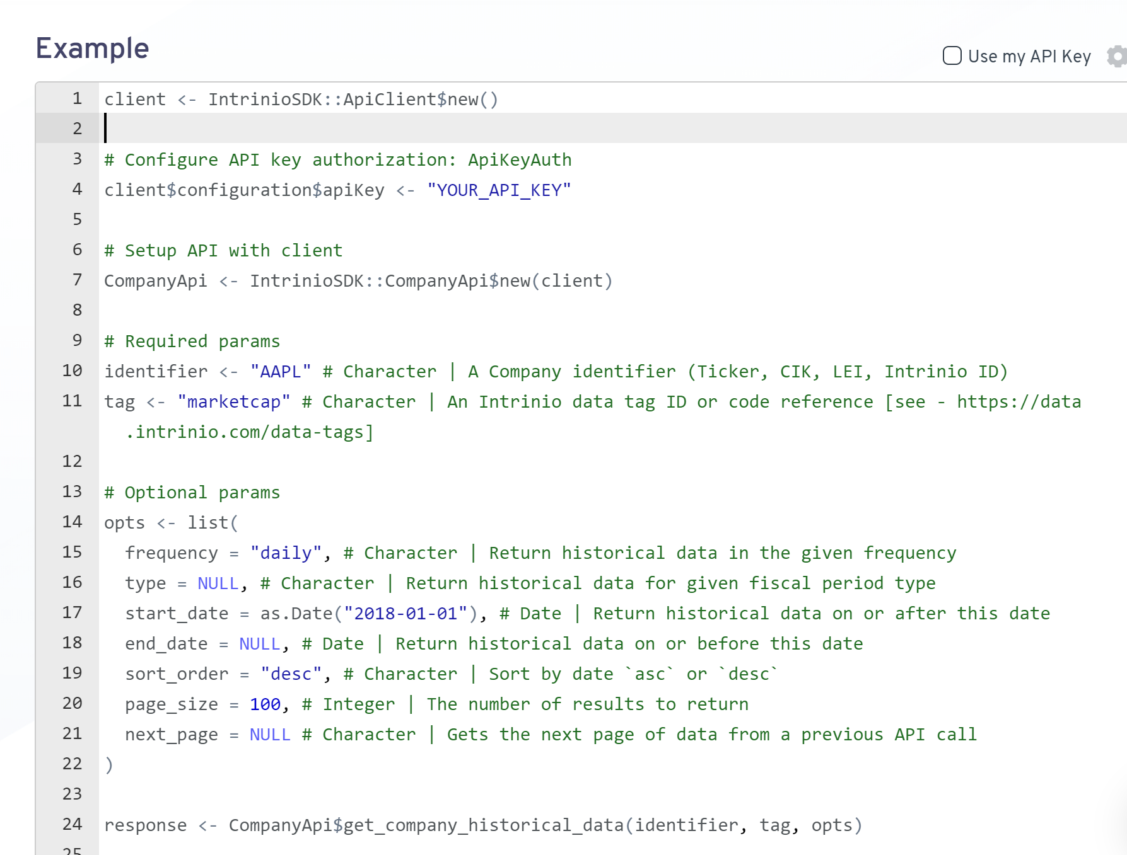
Running the API with “IntrinioSDK::” Historic Market Capitalization Data

Slide 5
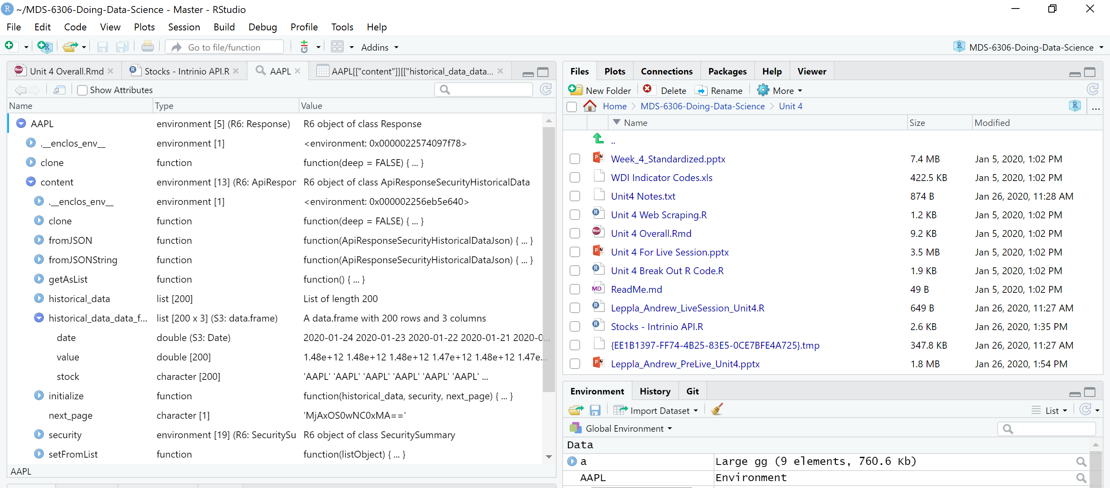
Challenge #2 - Finding the Data The API made a new Environment for each query

Slide 6
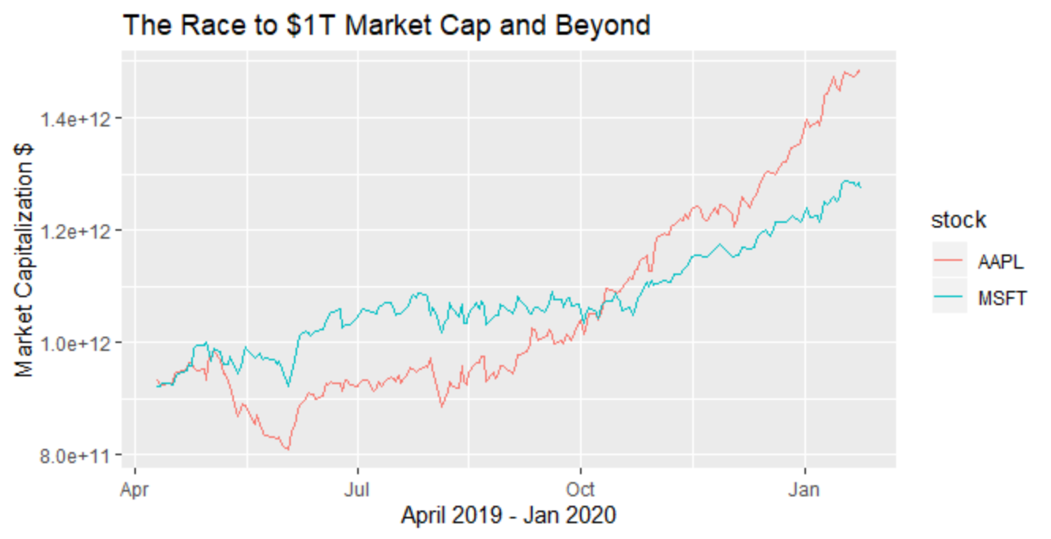
EDA - After a close spring race, Microsoft gets to $1T first and keeps a consistent lead Challenge #3 – API limits with unpaid acct. No access to Alphabet (Google) data, limited queries
Notes:
client <- IntrinioSDK::ApiClient$new()
# Configure API key authorization: ApiKeyAuth
client$configuration$apiKey <- “Your_API_Key“
#Market Caps
## Required params
identifier <- "AAPL" # Character | A Security identifier (Ticker, FIGI, ISIN, CUSIP, Intrinio ID)
tag <- "marketcap" # Character | An Intrinio data tag ID or code reference [see - https://data.intrinio.com/data-tags]
## Optional params
opts <- list(
frequency = "daily", # Character | Return historical data in the given frequency
type = NULL, # Character | Filter by type, when applicable
start_date = as.Date("2019-01-01"), # Date | Get historical data on or after this date
end_date = NULL, # Date | Get historical date on or before this date
sort_order = "desc", # Character | Sort by date `asc` or `desc`
page_size = 200, # Integer | The number of results to return
next_page = NULL # Character | Gets the next page of data from a previous API call
)
AAPL <- SecurityApi$get_security_historical_data(identifier, tag, opts)
AAPL[["content"]][["historical_data_data_frame"]]$stock="AAPL"
identifier <- "MSFT" # Character | A Security identifier (Ticker, FIGI, ISIN, CUSIP, Intrinio ID)
MSFT <- SecurityApi$get_security_historical_data(identifier, tag, opts)
MSFT[["content"]][["historical_data_data_frame"]]$stock="MSFT"
##Merge the Environment data frames
MCap=rbind(AAPL[["content"]][["historical_data_data_frame"]] , MSFT[["content"]][["historical_data_data_frame"]])
##Plot market cap vs. time
MCap %>% ggplot(aes(x=date,y=value,color=stock))+geom_line() + ggtitle("First to $1T Market Cap") +
ylab("Market Capitalization $") + xlab("April 2019 - Jan 2020")

Slide 7
Apple overtakes Microsoft as the world’s most valuable company in Oct-Nov 2019 and doesn’t look back
Notes:
client <- IntrinioSDK::ApiClient$new()
# Configure API key authorization: ApiKeyAuth
client$configuration$apiKey <- “Your_API_Key“
#Market Caps
## Required params
identifier <- "AAPL" # Character | A Security identifier (Ticker, FIGI, ISIN, CUSIP, Intrinio ID)
tag <- "marketcap" # Character | An Intrinio data tag ID or code reference [see - https://data.intrinio.com/data-tags]
## Optional params
opts <- list(
frequency = "daily", # Character | Return historical data in the given frequency
type = NULL, # Character | Filter by type, when applicable
start_date = as.Date("2019-01-01"), # Date | Get historical data on or after this date
end_date = NULL, # Date | Get historical date on or before this date
sort_order = "desc", # Character | Sort by date `asc` or `desc`
page_size = 200, # Integer | The number of results to return
next_page = NULL # Character | Gets the next page of data from a previous API call
)
AAPL <- SecurityApi$get_security_historical_data(identifier, tag, opts)
AAPL[["content"]][["historical_data_data_frame"]]$stock="AAPL"
identifier <- "MSFT" # Character | A Security identifier (Ticker, FIGI, ISIN, CUSIP, Intrinio ID)
MSFT <- SecurityApi$get_security_historical_data(identifier, tag, opts)
MSFT[["content"]][["historical_data_data_frame"]]$stock="MSFT"
##Merge the Environment data frames
MCap=rbind(AAPL[["content"]][["historical_data_data_frame"]] , MSFT[["content"]][["historical_data_data_frame"]])
##Plot market cap vs. time
MCap %>% ggplot(aes(x=date,y=value,color=stock))+geom_line() + ggtitle("First to $1T Market Cap") +
ylab("Market Capitalization $") + xlab("April 2019 - Jan 2020")

Slide 8
Takeaways and Questions
Takeaways
There is a lot to learn about XML, JSON, etc. to be proficient at web scraping
APIs can have some serious limitations
Pay to play - Intrinio
Prolonged process to get access - Twitter
Questions
How do you find xml files online for web scraping?

